Slide 1

Team Mendit
Walkthrough 2

Slide 2
Parent and friends approached for their inputs and feedback and was recorded and noted down by us

Slide 3
Discussion with family members (Rohan).
I had a discussion about the project with my parents. They thought it was a good idea, as there is definitely a dearth of applications to hire unskilled workers. My parents, also told me about the problems they faced while hiring a domestic help a few years back. The process of acquiring their services was cumbersome due to the agencies involved. They said that this project will be able to effectively cut out the middle-man, thus ensuring a fast and efficient method to hire workers. One problem, they pointed out, that our project should handle, should be verifying the authenticity of the workers on our platform. This is essential in order to gain the users trust, which will automatically increase the popularity of our application.

Slide 4
Inputs and suggestions by friends and family (Manan):
Family and friends suggestions:
Question 1: What do you think about the idea of the product?
Suggestions by family members:
Person one: I don't completely understand what you're trying to say. From what is written, it only gives the impression that this model is useful for classifying jobs, say data scientist, data engineer, business analyst etc.
Friend: As far as employer is concerned, what parameter would differentiate him from others? I'm just a beginner in ML, so I don't have much idea.
I from my one friend told: basically i want a system/ website that shows the recruits and recommends them jobs as per their resume. and the employer should be shown only those recruit profiles whom they are searching for as per their requirements that they would enter before hand in an application form.

Slide 5
Rakshith’s friends suggested the following things in a discussion.
I: moreover this platform will not only be for skilled recruits but also for the unskilled laborer's!
Friend: So basically when a person inputs their resume, you will categorize them as per the suitable job and store that person's id. The recruiter only has to filter as per job requirement. It's a great idea. But what if a person is equally skilled in networks as well as AI. Will he be included in both categories or there will be a bias?
I: He will be included in both to be honest so no bias.
Friend 2: U mean employees or recruits? Like for within company or for recruiting hires?
I told: Yup recruits only.
Friend 2: Haan for recruitment it's a good idea But then it needs to be very thorough Especially with keywords It's better to reject false negatives rather than accept false positives.

Slide 6
Business model Used
Value proposition: We will have some features for the visually impaired in our portal for instance transcript readers and immersive readers.
Target market: The target stakeholders will be the unskilled and skilled workers as well as vendors and employers who will hire them
Competitive advantage: The competitive advantage is the use of ML based recommendation system with the USP of website to be friendly for the visually impaired.
Cost structure: A list of the fixed and variable expenses your business requires to function, and how they affect pricing.
Key metrics: profit margins and the economic growths per year and also the number of customers served and satisfied per unit time.
Resources: The physical, financial, and intellectual assets of your company including the website and algorithms used and the human resources used.
Problem and solution: The problem is that people especially housewives not able to find house help or vendors not able to outsource unskilled and skilled labor easily we will mediate between them efficiently.
Revenue model: Given as a balance sheet later with cost and expenditure.
Revenue streams: Through advertisements on our portal from commercial partners and as well as from the employers and vendors using our portal regularly using a subscription.
Profit margin: The amount your revenue exceeds your business costs.

Slide 7
Balance sheet and cost estimation:
Ongoing expenses
Rent
Payroll
Taxes
Legal services
Loan payments
Insurance payments
Utilities
Marketing costs
One-time expenses
Permits and licenses
Incorporation fees
Logo design
Website design
Brochure and business card printing
Signage
Down payment on rental property
Improvements to chosen location

Slide 8
Road map to be followed for the completion of the Startup process and deployment:
Completion of analysis and requirement understanding.
Analysing requirements and requirement specification designing and risk analysis.
Coding and implementation design and GUI and backend.
Embedding ML algorithm and testing/ reviewing.
Legal matters and terms and conditions defined.
Build a Help and feedback system and maintainence

Slide 9
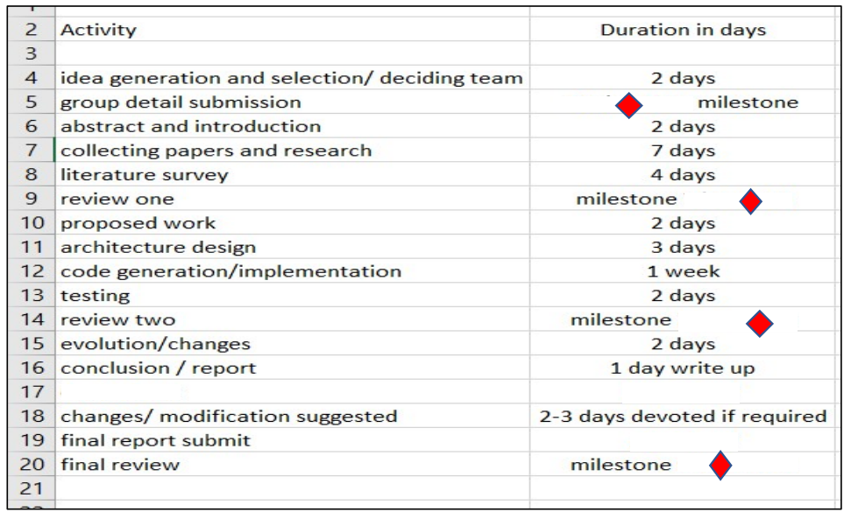
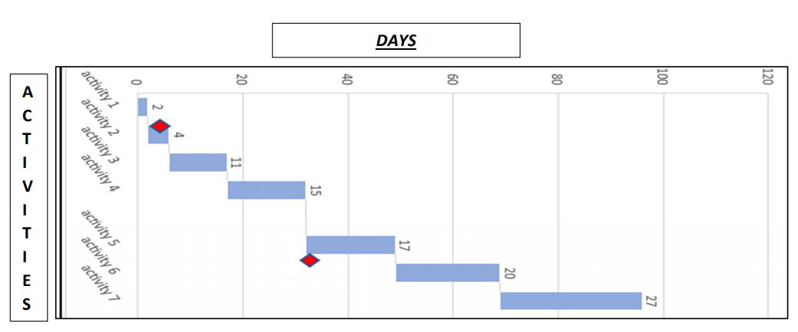
Activity duration and time estimation using a Gantt chart:

Slide 10
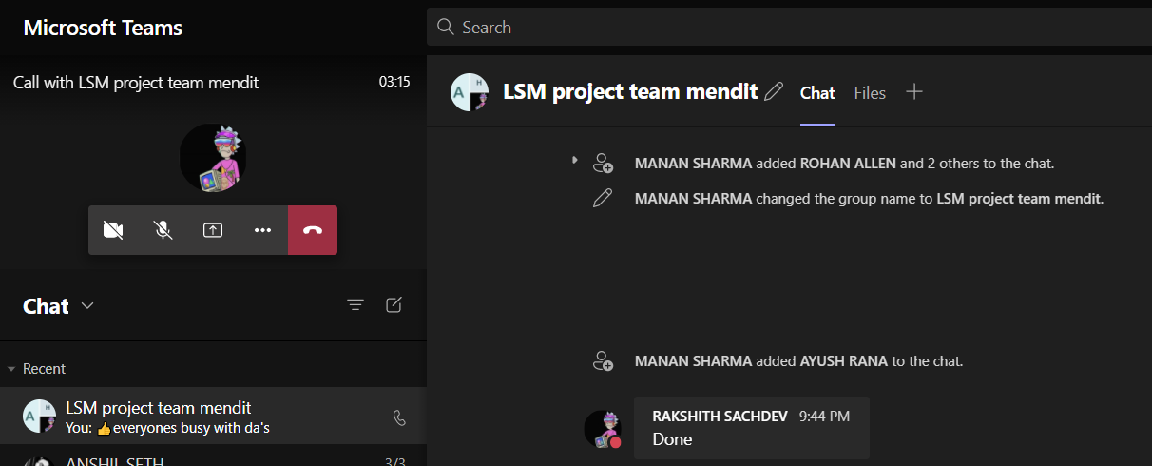

Slide 11
MOMs 1,2,3
1. Discussion and distribution of research papers for the survey of the literature.
Distribution of the work and papers 4-5 paper each person.
Mom 2:
Discussion and selection of questions for the review and surveys.
Making forms and google survey and planning to get responses for the same.
Observation and collection of functional requirements of our system.

Slide 12
MOM 3
Business model decisions
Cost estimation factors decided and noted down
Interviews and responses from parents and friends noted doen and documented to be followed while working.
Survey and marketing analysis done efficiently to extract the requirements.
MOM 4:
Road map decide and detailed road map created for the future and discussion on the inputs given by family members and parents.

Slide 13
